Slide 1
PlanWise Setup Instructions
Powerful Devs – hack together
Soha jain, Shriya V R, Priyanka kamakoti

Slide 2
Setup
Two SharePoint Lists are to be created namely – PlanWiseTasks and Streak
The solution is to be imported, and the Power Automate flows need to be modified to accommodate your SharePoint lists. Ensure that the connectors are correct.
PlanWiseTask List Columns -
Title: Type -Text
TaskStartTime: Type - Date and Time TaskEndTime: Type - Date and Time
TaskStatus: Type - Choice, with two choices "Completed" and "Pending", Default: Pending
Attachment: Type - Attachment
Streak List Columns -
Streak : Type - Number , Default : 0
Initial Value Set: Type- Yes/No, Default: No
Date, Type: Date and Time
Add a record with Title as LastModifiedStreak and all the other columns left as it is

Slide 3
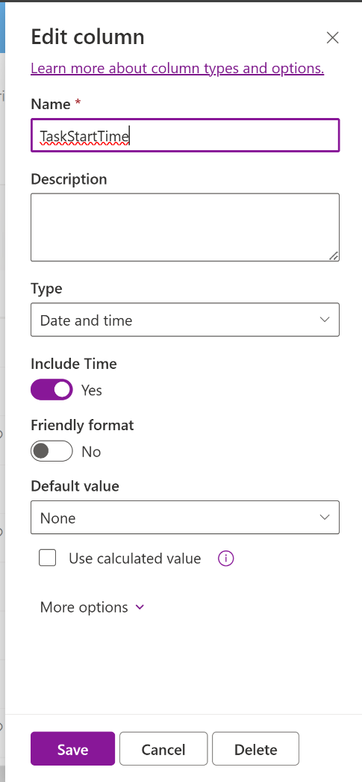
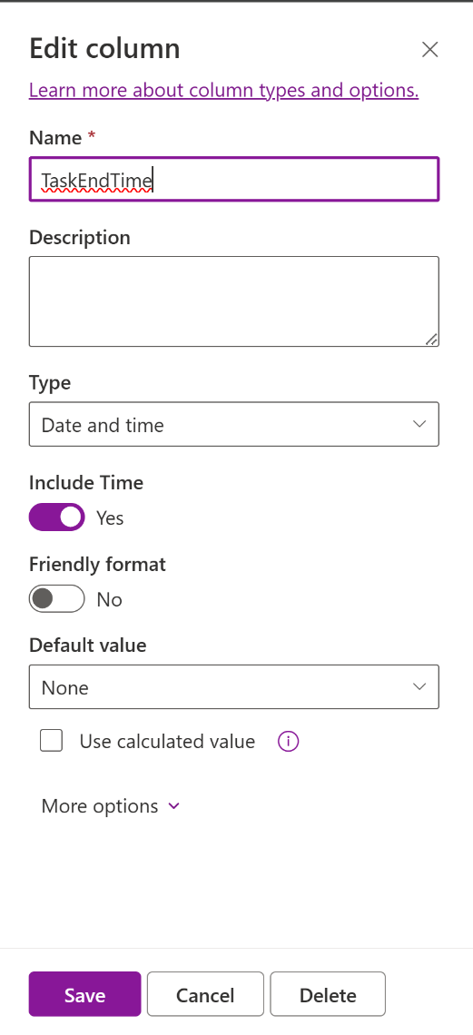
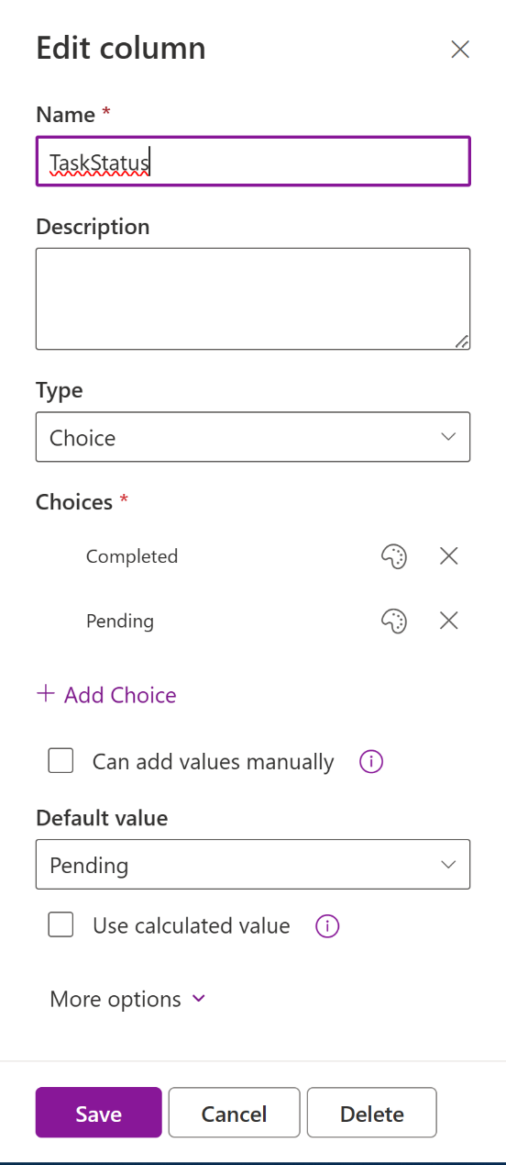
PlanWiseTasks - TaskStartTime, TaskEndTime and TaskStatus

Slide 4
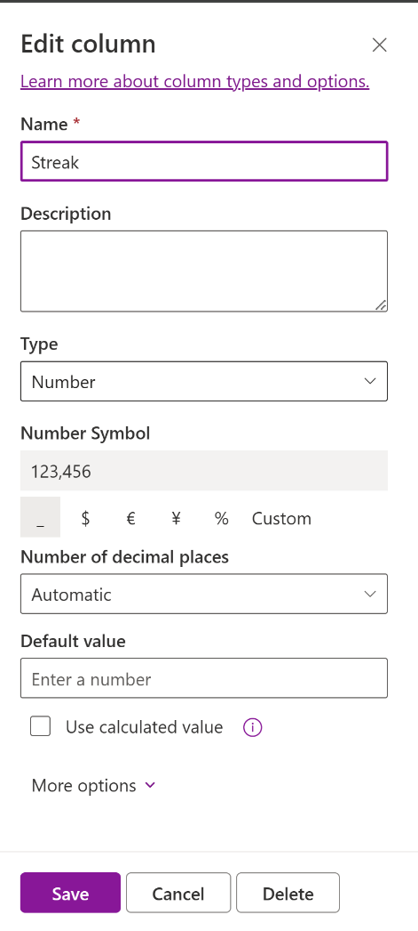
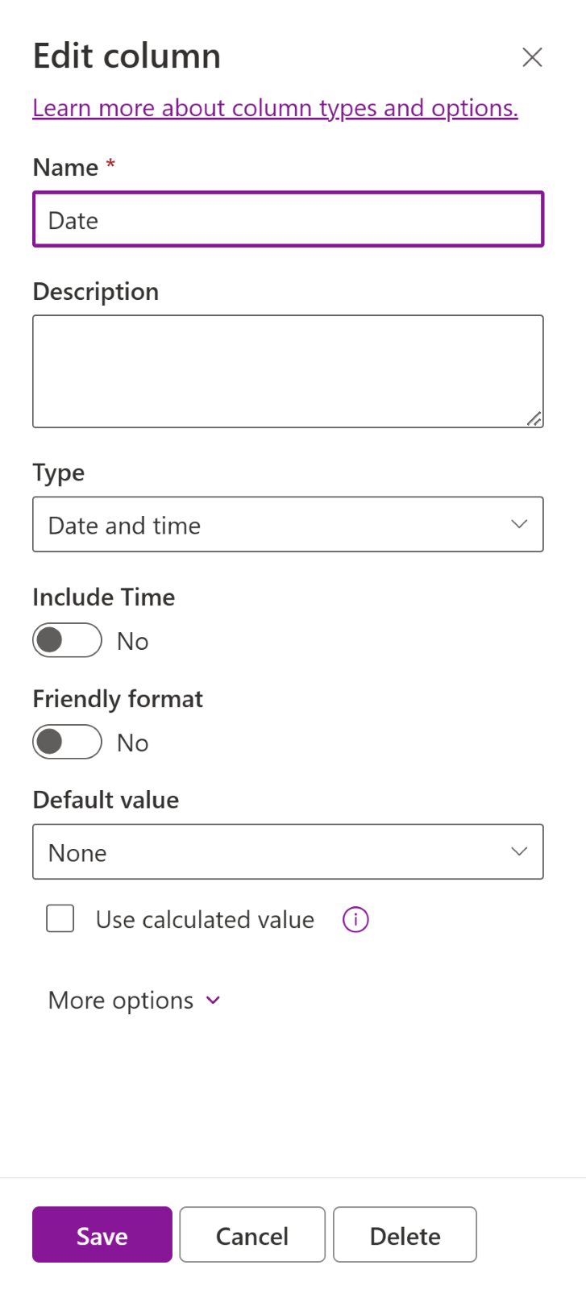
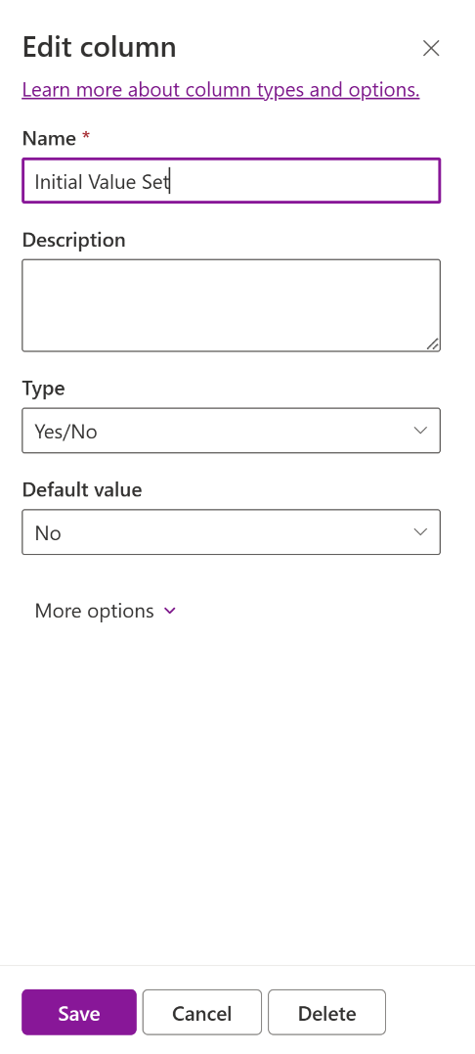
Streak - Initial Value Set, Streak, Date

Slide 5
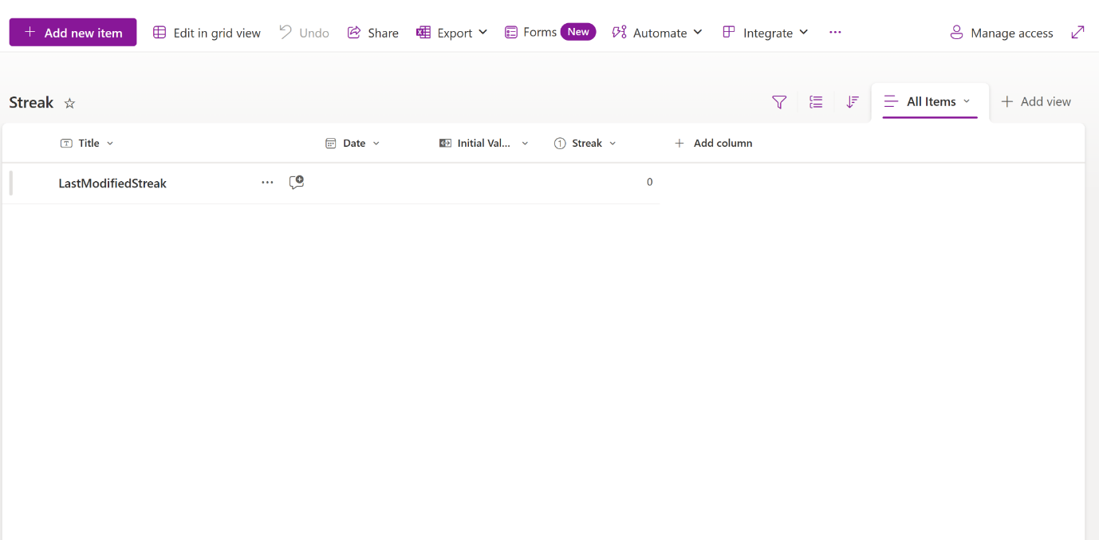
Streak List

